Slide 1


Titolo presentazione sottotitolo
Speculator Overview
Bernardo Camajori T. Cristian C. Spagnuolo Daniele Carta
Elia Battiston
Milano, XX mese 20XX

Slide 2
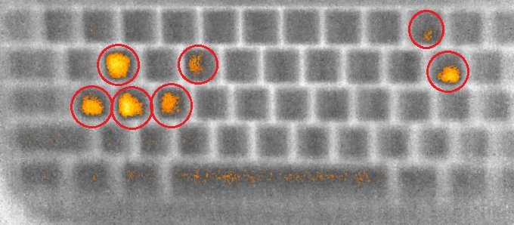
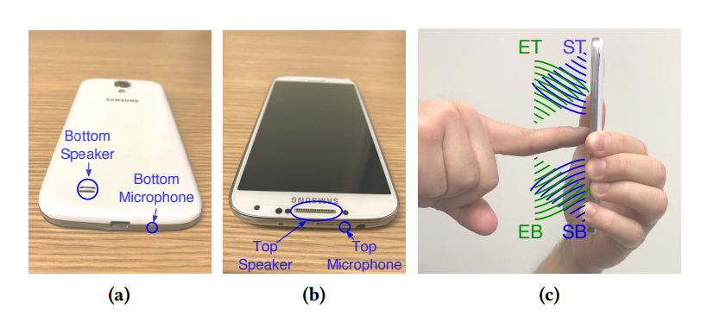
Exploiting physics
Side channel attacks take advantage of patterns in the information exhaust that machines and users constantly give off:
Thermal camera capturing user’s fingerprints
Using phone’s microphones and speakers to retrieve touchscreen inputs

Slide 3





Focusing on time
Cache side-channel attacks: prime+probe, evict+probe, flush+reload
Victim accessed
Fast
Slow
Victim didn’t access
Attacker
flush
Victim
accesses
or doesn’t accesses
Attacker
reload

Slide 4
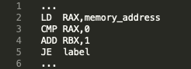

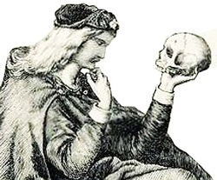
Speculative execution
Execute line 2 //sloooow
Maybe fit in that line 4, it’s independent
We have to compare something to proceed!
To take
OR
Not to take
Branch Direction Predictor's guess

Slide 5
Speculative execution
So what if we run the next instrutions anyway
Speculatively?
Instruction commit
Spared time
Right BDPrediction
Instruction execution rollback,
Registers flush
We can force
Wrong BDprediction
But what about the cache..?

Slide 6


Speculative execution attacks
That was spectrev1,
One example of
Speculative Execution Attacks (SEAs)
Further investigation on
Speculative Execution is required.
A tool which allows us to make it
Would be useful.

Slide 7
Speculator
Goals of the paper:
Find techniques to infer the microarchitectural state
Provide a tool to test microarchitectural behavior
Use the tool to study speculative execution in CPUs

Slide 8
Microarchitectural state
Counters
0 | 1
1 | 0
1 | 1
1 | 1
0 | 0
Instruction | Result
SUB | 0x12
ADD | 0x76
LEA | ?
Tail
Branch address
Prediction
Head
Branch predictors
Reorder buffer

Slide 9
What are performance counters?
ring0
instruction
Start counting μops
Resume
Execution…
ISSUED = 275
EXECUTED = 275
SINGLE_MUL = 3
SLOW_LEA = 12
...
ring0
instruction
Stop counting &
collect results

Slide 10
Performance counters as markers
mov eax, 0
jz eax
Correct branch
mov eax, 5
add eax, ebx
sub eax, 2
sub ebx, 2
nop
nop
div ecx
EXECUTED DIV = 0
...
EXECUTED DIV = 1
...

Slide 11
Best markers to study speculation
Intel markers
UOPS_EXECUTED.CORE/THREAD
UOPS_ISSUED.SINGLE_MUL
UOPS_ISSUED.SLOW_LEA (lea rax,[array+rax*2])
LD_BLOCKS.STORE_FORWARD:
mov DWORD[array], eax
mov DWORD[array +4], edx
movq xmm0 , QWORD[array]

Slide 12
Best markers to study speculation
AMD Zen markers
DIV_OP_COUNT
NUMBER_OF_MOVE_ELIMINATION_AND_ SCALAR_OP_OPTIMIZATION

Slide 13
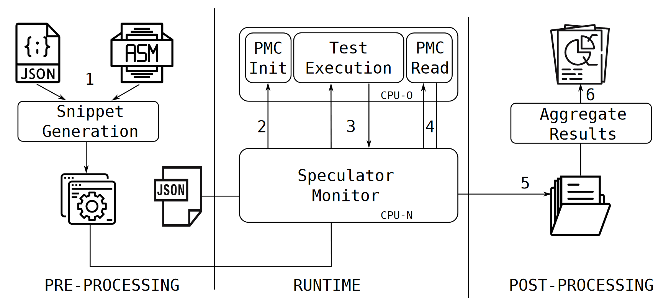
Speculator

Slide 14
Studying the behavior of CPUs
Tests performed:
RSB (Return Stack Buffer) size
Verification of the UOPS_ISSUED.SINGLE_MUL maker reliablity
Speculative execution accross system calls
Effect of the NX bit while executing speculatively

Slide 15
Studying the behavior of CPUs
Tests performed:
Nested branches
Effects of cflush
Size of the «speculation window»
Speculation triggered by the MPX instruction set
Stopping speculation with lfence

Slide 16
Return stack buffer
Objective: RSB length.
Snippet: Contains an increasing number of nested calls.
Paper Results:
Intel Kaby Lake(7th gen) RSB size: 16 entries
AMD Ryzen RSB size: 32 entries

Slide 17
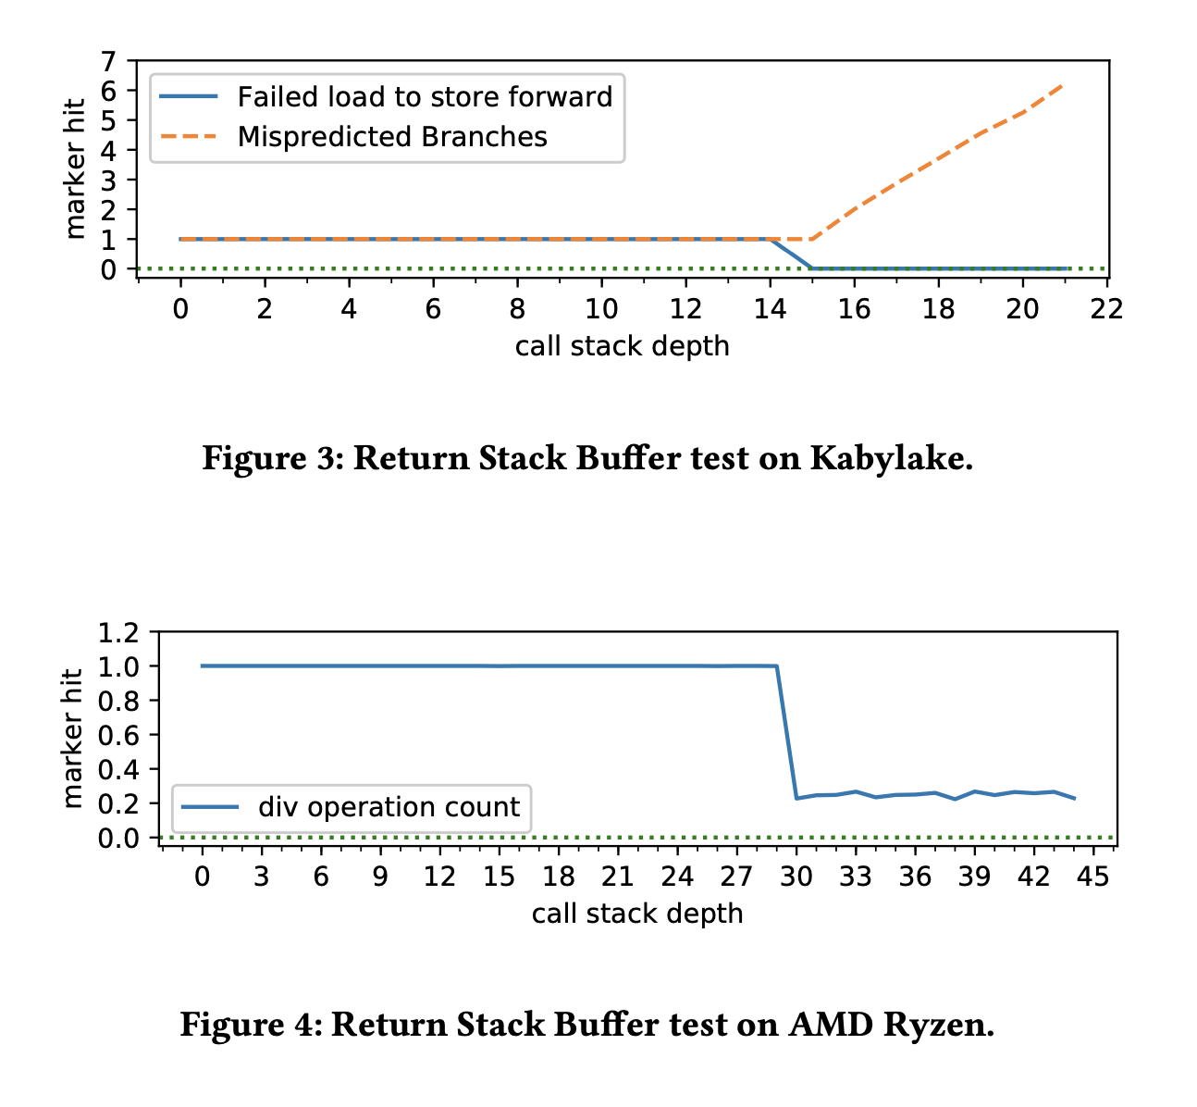
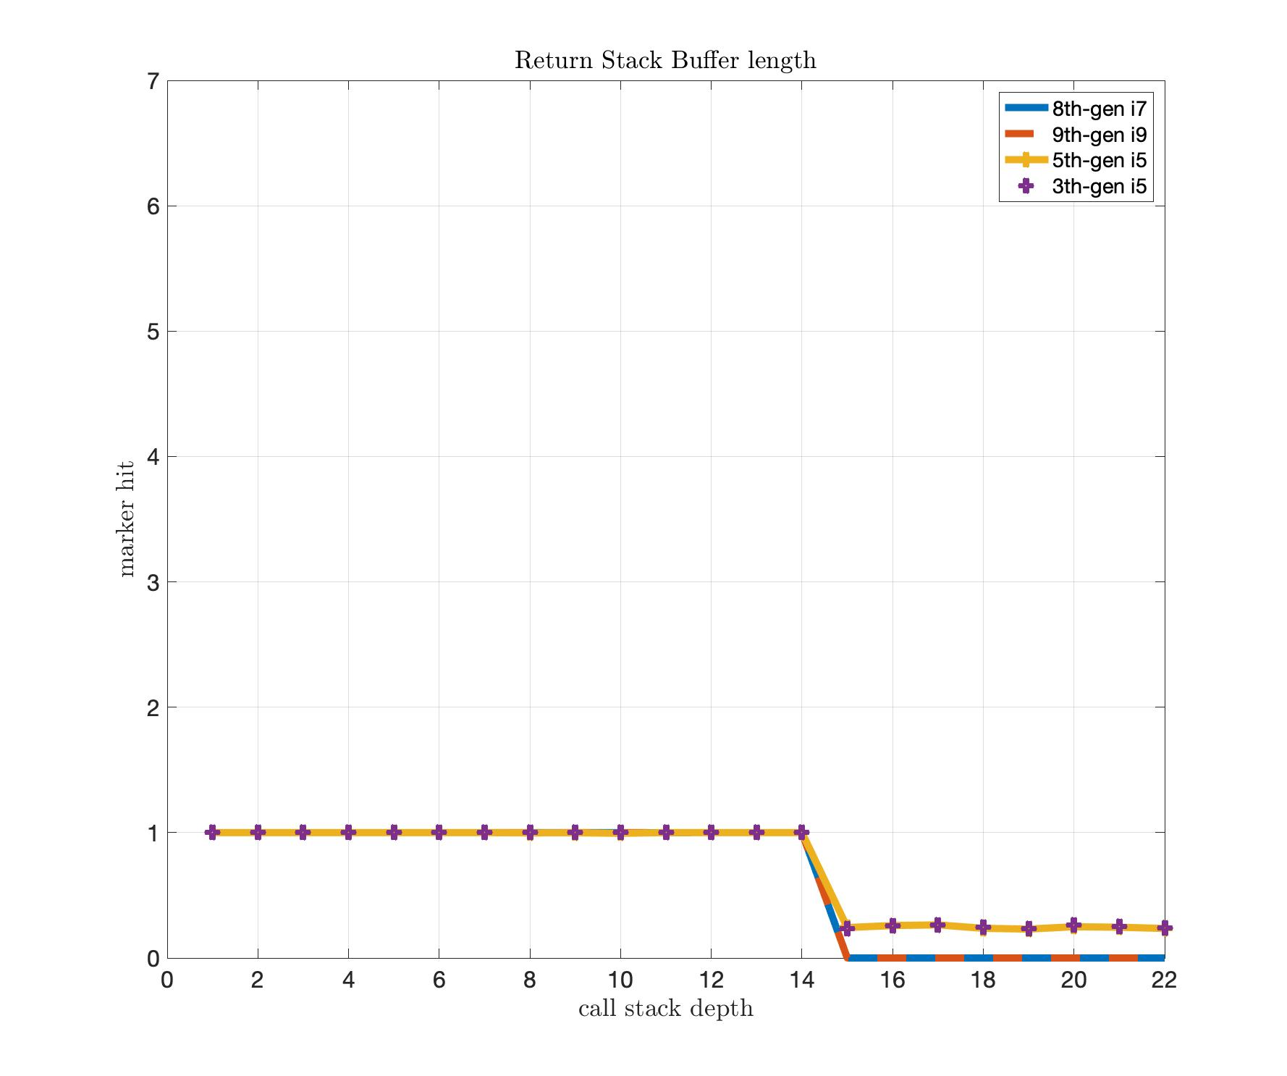
Return stack buffer

Slide 18
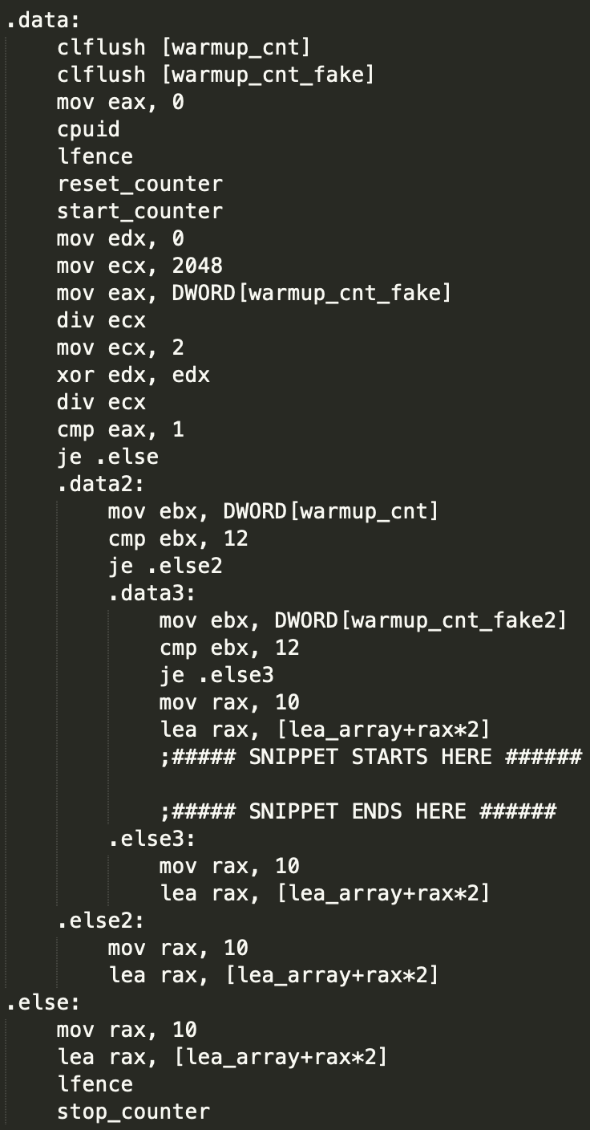
Nesting speculative execution
Objective: Verify behavior of Speculative execution along nested branches.
Snippet: Contains three nested conditional branches.
Markers: UOPS_ISSUED.SLOW_LEA
Paper Results: Indeed Speculative execution continues along trained branch targets for all branches.

Slide 19
Nesting speculative execution
8th-gen i7:
UOPS_ISSUED.SLOW_LEA: average: 10.9791666667, std deviation: 0.203058215517
9th-gen i9:
UOPS_ISSUED.SLOW_LEA: average: 11.22340425531915, std deviation: 0.41652706277557217
5th-gen i5:
UOPS_ISSUED.SLOW_LEA: average: 13.9677419355, std deviation: 0.309408485375

Slide 20
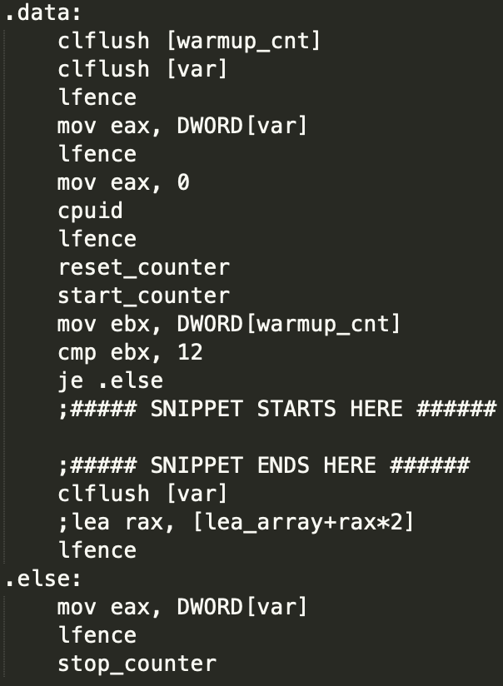
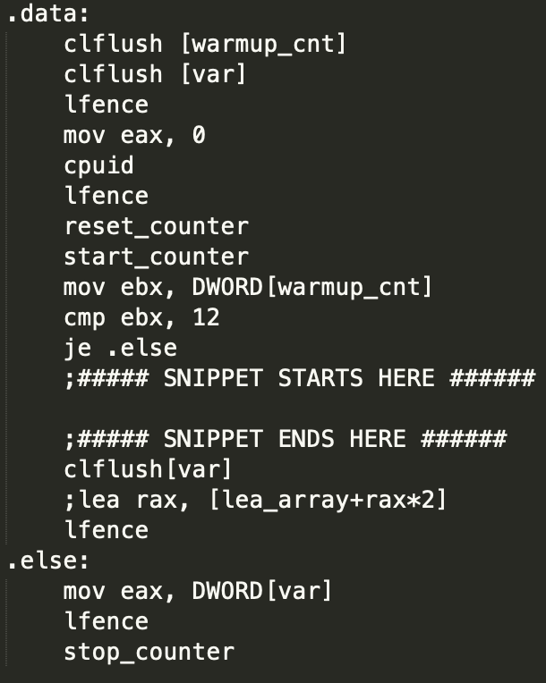
Flushing the cache
Objective: Verify behavior of clflush when executed speculatively.
2 Snippets:
Markers: CYCLES
Paper Results: Through clflush, the attacker cannot extend the speculation window.
Cached
Final load
Final load

Slide 21
Flushing the cache
8th-gen i7:
Cached:
CYCLES: average: 389.516563147, std deviation: 17.8364212896
Uncached:
CYCLES: average: 624.385427666, std deviation: 53.5677715102
9th-gen i9:
Cached:
CYCLES: average: 412.92967818831943, std deviation: 45.06317709276406
Uncached:
CYCLES: average: 669.4697773064687, std deviation: 59.65902484667013
5th-gen i5:
Cached:
CYCLES: average: 253.261603376, std deviation: 9.87362778817
Uncached:
CYCLES: average: 379.707112971, std deviation: 6.98324291595
3th-gen i5:
Cached:
CYCLES: average: 344.41492865, std deviation: 20.3631993288
Uncached:
CYCLES: average: 577.40247678, std deviation: 35.1792261217

Slide 22
Speculation window size: conditional branches
Objective: Speculation window size, depending on the type of instructions needed to resolve the branch.
2 Snippets:
v1_cond, trigger of speculative execution.
v1_nocond, baseline with no condition.
Markers: CYCLES
Paper Results:

Slide 23
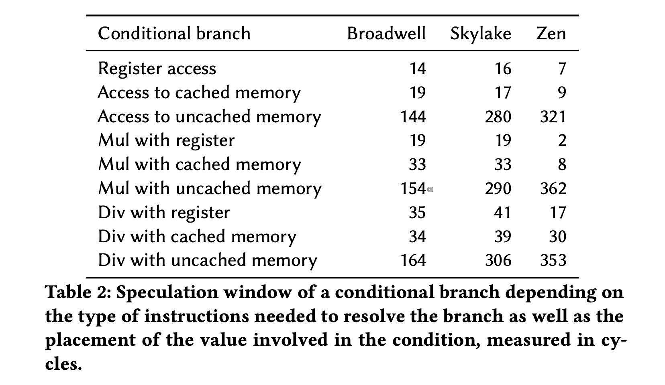
Speculation window size: conditional branches

Slide 24
Speculation window size: conditional branches
Conditional branch | 9th-gen i9 | 8th-gen i7 | 5th-gen i5 | 3th-gen i5
Register access | 14 | 13 | 14 | 17
Access to cached memory | 16 | 27 | 25 | 28
Access to uncached memory | 302 | 283 | 155 | 246
Mul with register | 17 | 25 | 21 | 24
Mul with cached memory | 32 | 37 | 33 | 36
Mul with uncached memory | 329 | 296 | 159 | 268
Div with register | 42 | 41 | 41 | 40
Div with cached memory | 47 | 56 | 50 | 52
Div with uncached memory | 330 | 304 | 177 | 268

Slide 25
Speculation window size: store to load forwarding
Objective: Verify behavior of a failed store to load forwarding.
Snippet: Contains sequence of store and load operations.
Markers: UOPS_EXECUTED and UOPS_RETIRED.
Paper Results: A failed store-to-load forwarding creates a situation similar to speculative execution results being discarded because of a mispredicted branch.

Slide 26
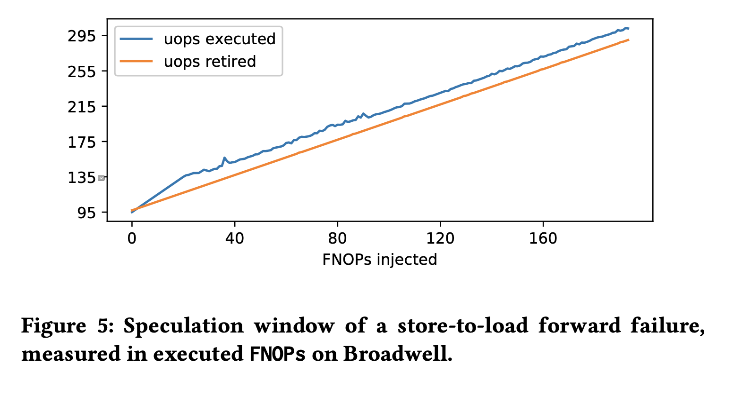
Speculation window size: store to load forwarding

Slide 27
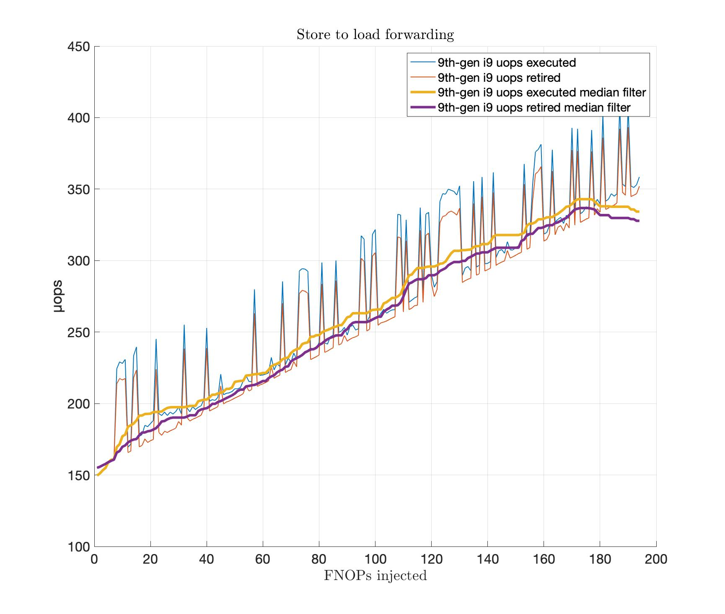
Speculation window size: store to load forwarding

Slide 28
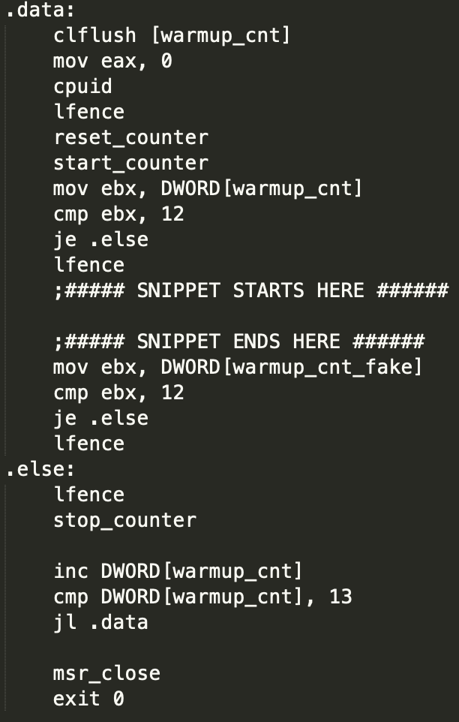
Speculation stopper
Objective: Verify that lfence stops speculative execution.
Snippet:
Markers: UOPS_EXECUTED.
Paper Results: Executed μops remains constant among the test runs, irrespective of the number of instructions following lfence.

Slide 29
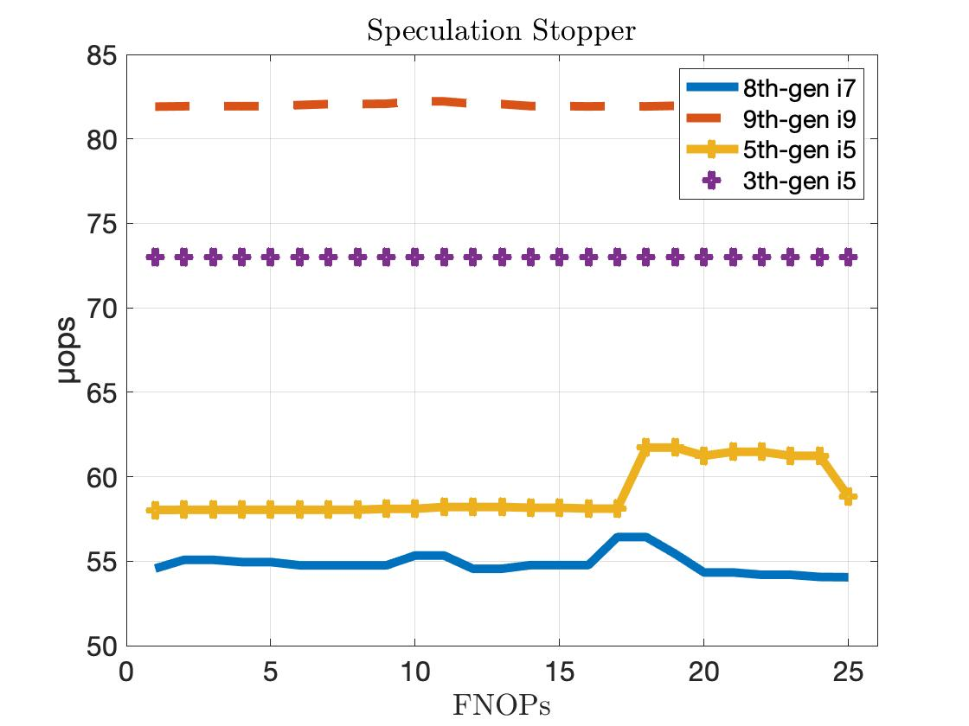
Speculation stopper

Slide 30
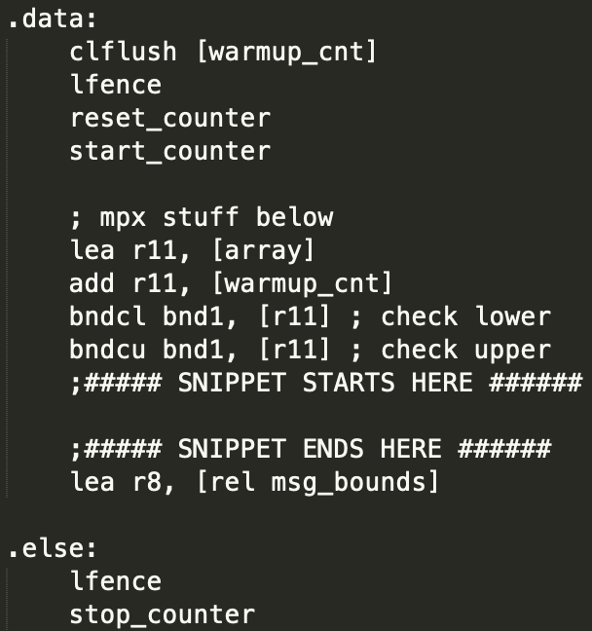
Memory protection extension
Objective: Measure if and how much code following a bounds check instruction is speculatively executed.
Snippet:
Markers: UOPS_EXECUTED.
Paper Results: Speculatively execute the marker instruction for a sled of up to 22NOPs.

Slide 31
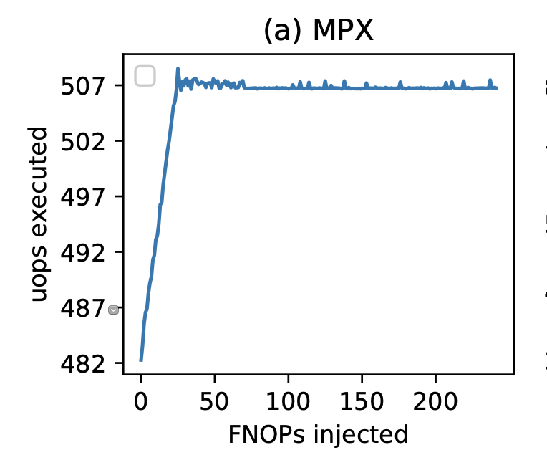
Memory protection extension

Slide 32
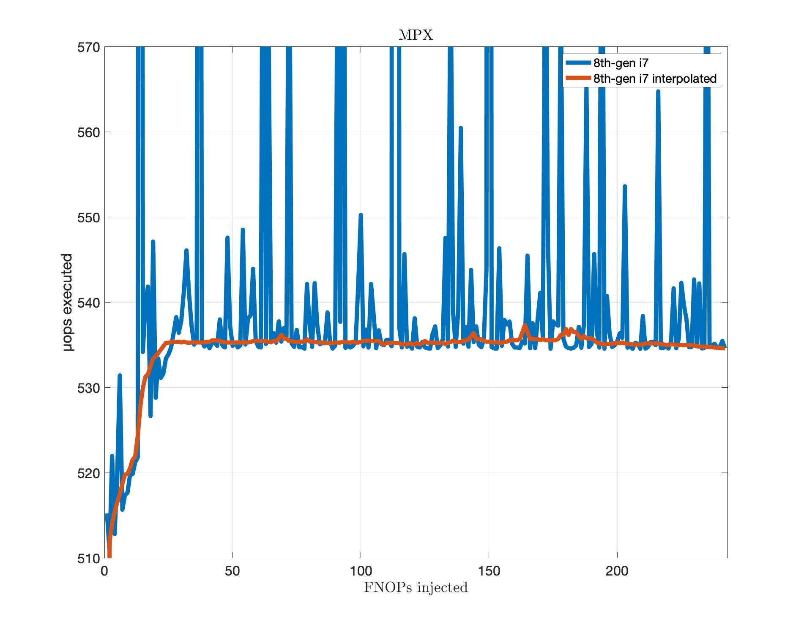
Memory protection extension

Slide 33
Issued vs execute code
Objective: Verify that UOPS_ISSUED counters can be confidently used to indicate speculative execution.
Snippet: just contains an increasing number of RIP relative load instructions.
Markers: UOPS_EXECUTED.
Paper Results: instructions are not only issued but its speculative execution does takes place.

Slide 34
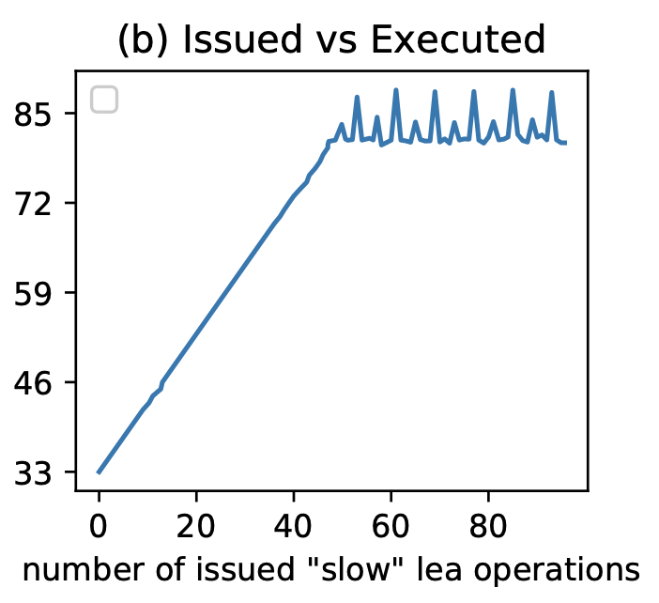
Issued vs execute code

Slide 35
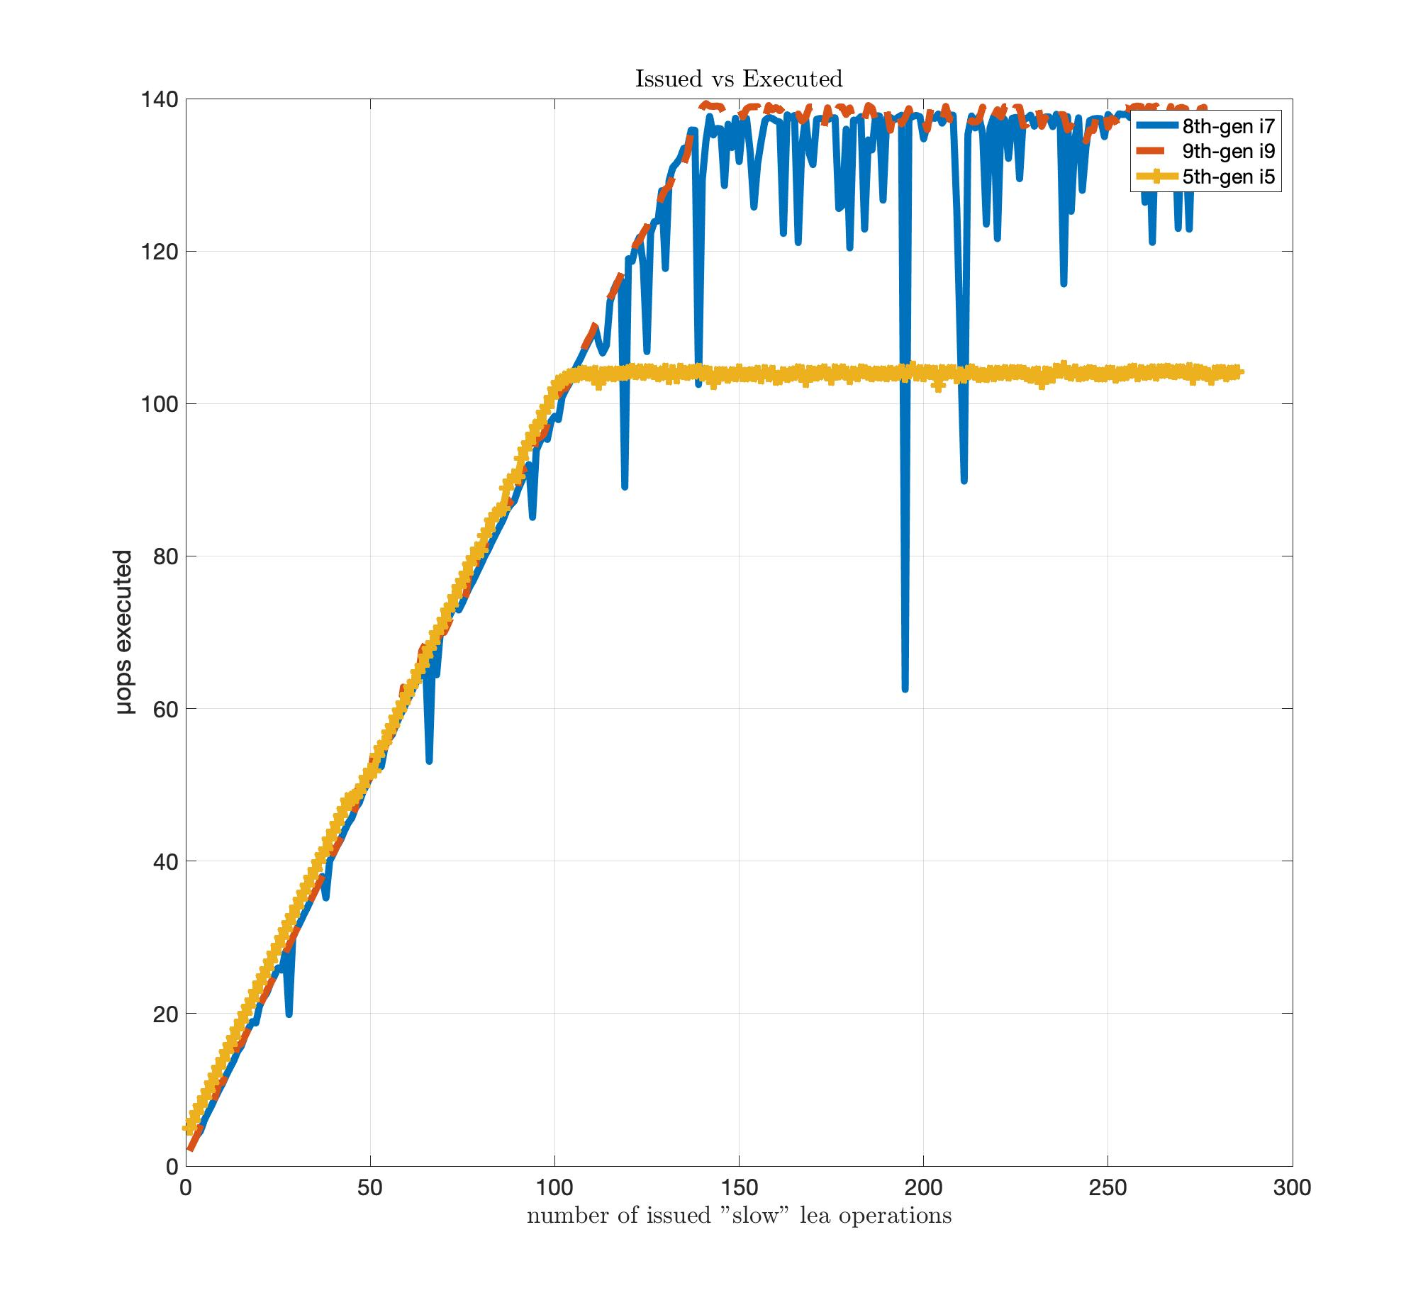
Issued vs execute code
Notes:
And now we will show our thoughts and conclusions about this paper. I give the floor to Cristian.

Slide 36



Paper Overview
404 Documentation not found
Reverse Engineering

Slide 37


Paper Overview
Limitations:
Administrator privileges
OS running on bare-metal
Noise-free environment
PROs
Flexibility
Code-generation tooling

Slide 38

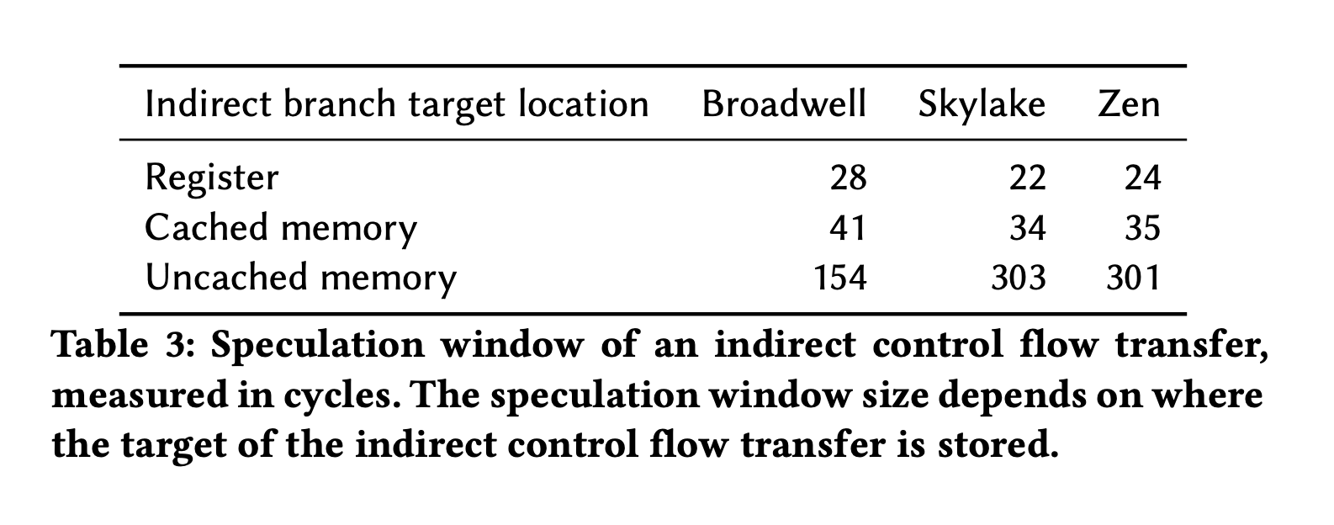
Exeptions in Experiment Reproducibility
AMD processors
Speculation windows wize: indirect branches
Indirect branch | 8th-gen i7 | 9th-gen i9 | 5th-gen i5
Register | 118 | 116 | 108
Cached memory | 131 | 118 | 125
Uncached memory | 129 | 114 | 125

Slide 39
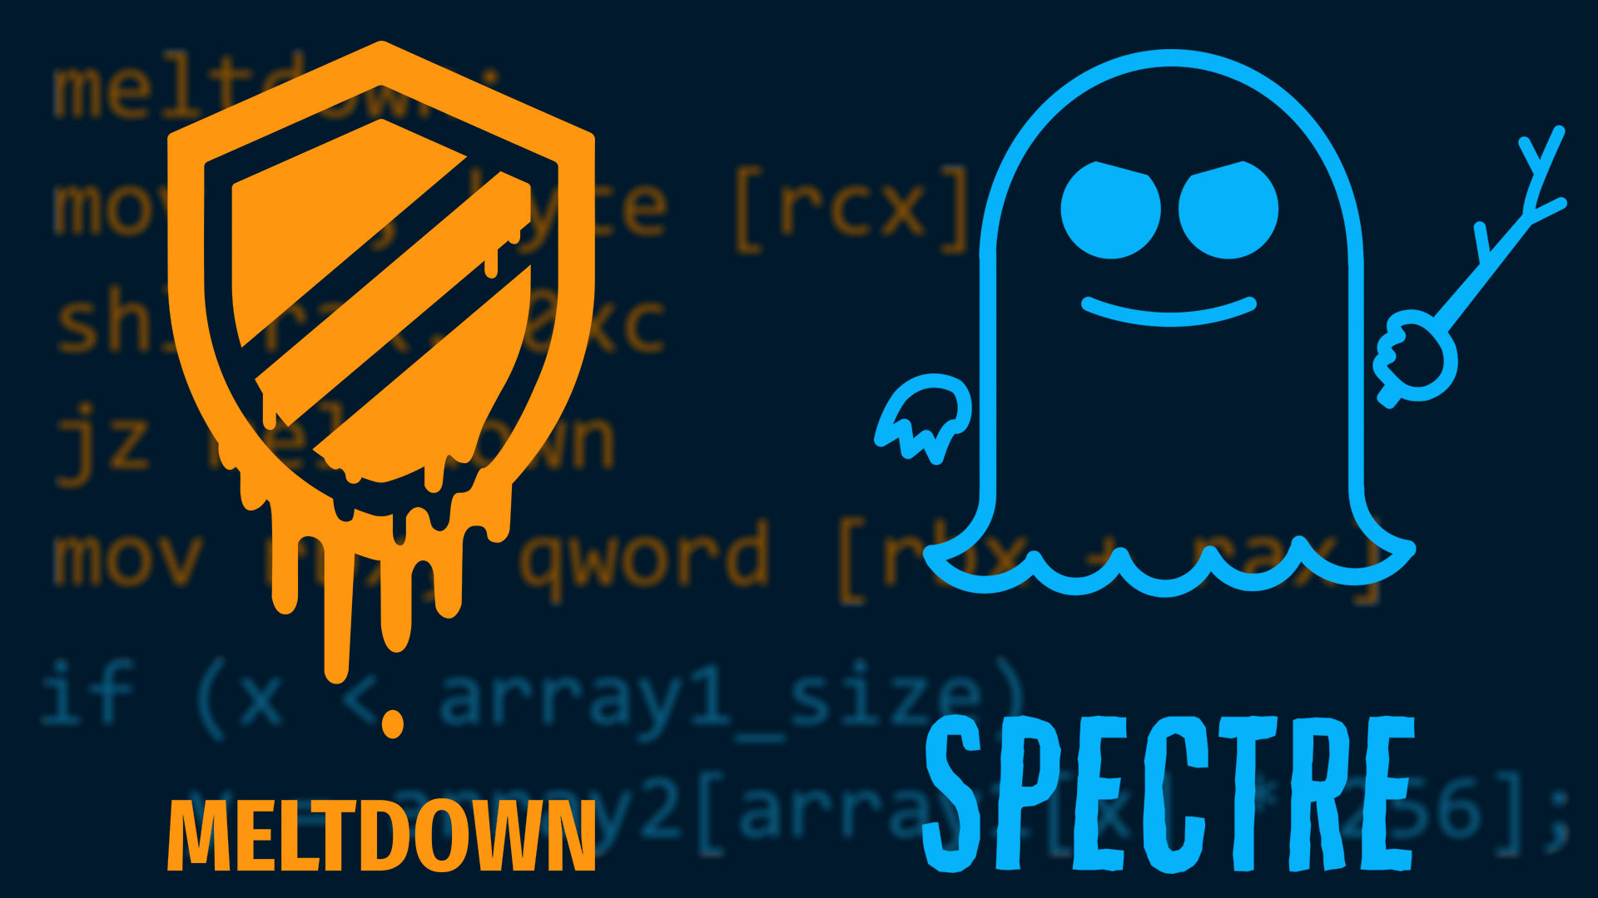

Speculative Execution Attacks, Mitigations & Future Researchs
Speculative Execution Attacks:
Bound Check Bypass (BCB)
Branch Target Injection (BTI)
Rogue Data Cache Load (RDGL)
Mitigations:
BCB: barriers (LFENCE), data dependencies
BTI: additional interface, retpoline
Rogue Data Cache Load: KAISER

Slide 40

Any Questions?

